Slide 1


Slide 2

Java OOP and Data Structures with Introduction to Secure Coding Dr. Ziping Liu
Chapter 20 AVL Trees

Slide 3
https://he.kendallhunt.com/product/java-oop-and-data-structures-introduction-secure-coding
Chapter 20 AVL Trees

Slide 4

Chapter Outlines
What is an AVL tree
Techniques to balance a binary search tree
Iterative implementation in insertion in an AVL tree
Recursive implementation in insertion in an AVL tree
Iterative implementation in deletion in an AVL tree
Recursive implementation in deletion in an AVL tree
Application driver for the AVL tree class

Slide 5
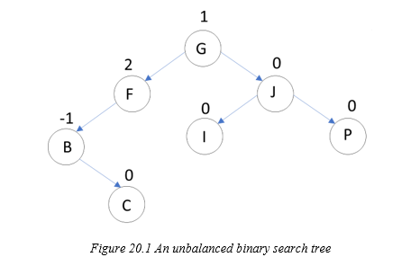
20.1 What Is an AVL Tree?
a self-balancing binary search tree
Its balance is maintained by ensuring that the height difference (balance factor) between a node’s left and right subtrees does not exceed one

Slide 6
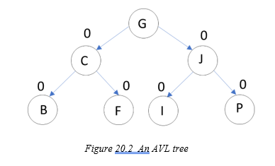
20.1 What Is an AVL Tree?
To balance a binary search tree, each node must be balanced. This is typically achieved by calculating a node's balance factor, which is the height difference between its left subtree and right subtree. A balanced node will have a balance factor of -1, 0, or 1.

Slide 7
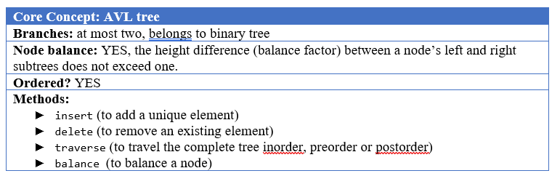
20.1 What Is an AVL Tree?

Slide 8
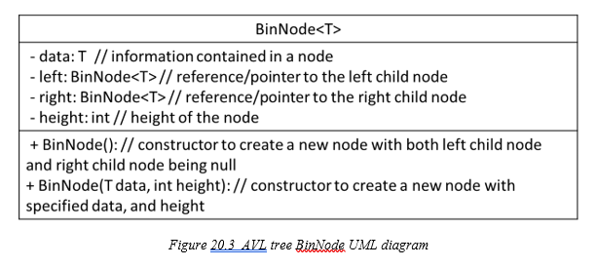
20.1 What Is an AVL Tree?

Slide 9
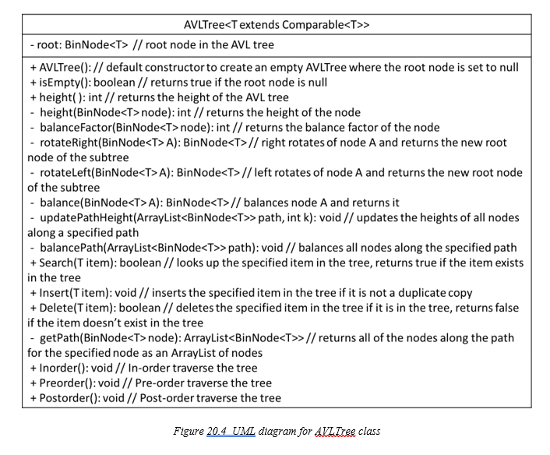
20.1 What Is an AVL Tree?

Slide 10
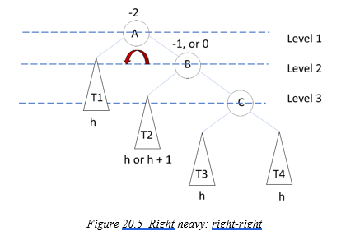
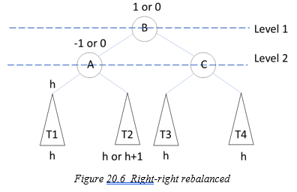
20.2 Techniques to Balance a Node in an AVL Tree
Case 1: right-right(right heavy)
To restore balance, a left rotation is performed on node A:
Node A’s right subtree, T2, becomes its right child.
Node A becomes the left child of node B.

Slide 11
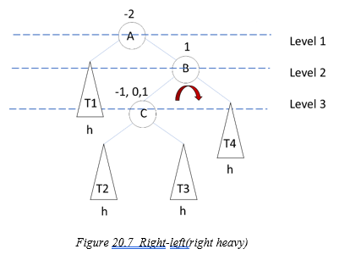
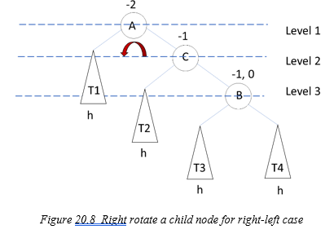
20.2 Techniques to Balance a Node in an AVL Tree
right-left(right heavy)
To restore balance:
Perform a right rotation on node B to make it the right child of node C.
Reassign T3 as the left subtree of node B

Slide 12
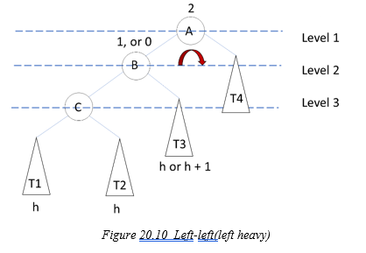
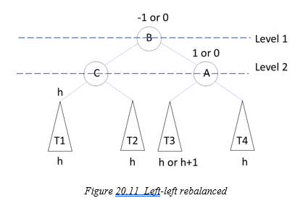
20.2 Techniques to Balance a Node in an AVL Tree
left-left(left heavy)
To restore balance:
Perform a right rotation on node A to make T3 the left subtree of node A.
Reassign node A as the right child of node B.

Slide 13
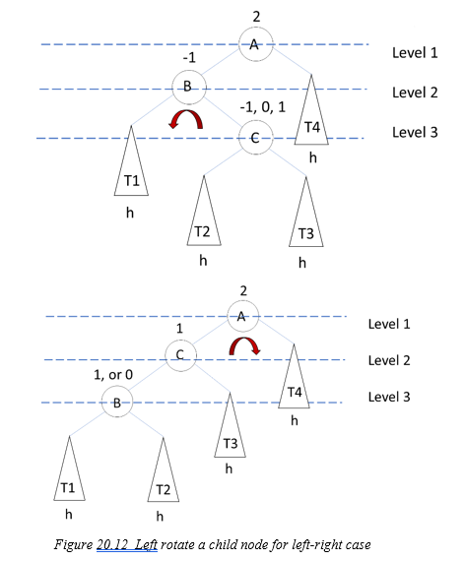
20.2 Techniques to Balance a Node in an AVL Tree
Left-right(left heavy)
To restore balance:
Perform left rotate node B to make it the left child of node C.
Make T2 the right subtree of node B.

Slide 14
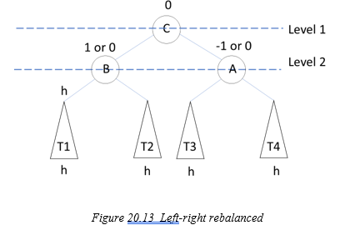
20.2 Techniques to Balance a Node in an AVL Tree
Left-right(left heavy)
To restore balance:
Perform left rotate node B to make it the left child of node C.
Make T2 the right subtree of node B.

Slide 15
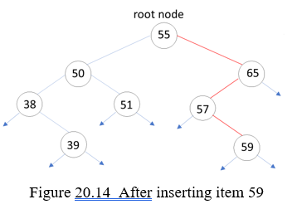
20.3 Iterative Implementation of Insertion in an AVL Tree
before inserting 59, the AVL tree is balanced.
After inserting 59, node 65 is not balanced
Thus, all nodes along the search path need to be rebalanced, starting at the parent node of the newly inserted node and moving up to the root node.

Slide 16


Slide 17


Slide 18
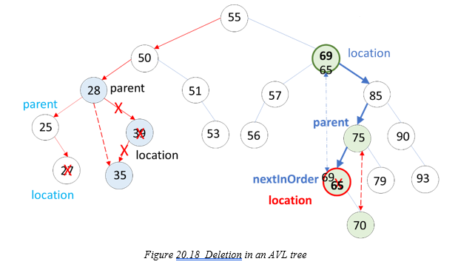
20.4 Iterative Implementation of Deletion in an AVL Tree
After deleting a node, update the heights of all nodes along the path from the root node to the parent node.
rebalance each node along this path. Balancing is performed bottom-up, starting from the parent node and moving up to the root node.

Slide 19
20.5 Recursive Implementation of Insertion and Deletion in an AVL Tree
Recursive InsertNode() method takes two parameters: a node and an item. The method recursively calls itself with either the left or right child of the current node until it reaches a null node or finds that the item is already present in the tree, at which point the recursion terminates.
To insert an item into an AVL tree, the Insert2() method calls the InsertNode() method, passing the root node as the starting node. After the node is inserted, the heights of all nodes along the search path are updated in a backward manner. Additionally, all nodes along the search path are balanced as part of this process.

Slide 20
20.5 Recursive Implementation of Insertion and Deletion in an AVL Tree
The recursive deleteNode() method takes two parameters: a node and an item. The method recursively calls itself with either the left or right child of the current node, provided the left or right child is not null or the item has not been found. If one of the child nodes is null, the method returns the other non-null child node.
If both child nodes are not null, the nextInOrder() method is called to find the next in-order node. Then, the recursive deleteNextInOrder() method is called to delete the next in-order node, balance the respective subtree, and reconnect the parent node with the updated subtree.
To delete an item from an AVL tree, the Delete2() method calls the deleteNode() method, passing the root node as the starting node. After the node is deleted, the heights of all nodes along the search path are updated in reverse order. Furthermore, all nodes along the search path are rebalanced as part of this process.

Slide 21
Which National Park is it?
Answer: Great Sand Dunes National Park and Preserve

